Slide 1

Early Analysis of Walkerton Data
This report is prepared based on Walkerton Hospital Admissions data. It is part of the ECADS project led by Dr. Richard Davies (rfdavies@ottawaheart.ca). We investigate the extent to which the hospital admissions data reveals the effects of the Walkerton Crypto outbreak in mid/late May 2000.
Andrew Moore | Professor | Computer Science, Carnegie Mellon | awm@cs.cmu.edu
Daniel Neill | Doctoral Graduate Student | Computer Science, Carnegie Mellon | neill@cs.cmu.edu
Robin Sabhnani | Senior Research Programmer and Masters Student | Computer Science, Carnegie Mellon | sabhnani+@cs.cmu.edu
Version 11, June 18th, 2005
Note to other teachers and users of these slides. Andrew would be delighted if you found this source material useful in giving your own lectures. Feel free to use these slides verbatim, or to modify them to fit your own needs. PowerPoint originals are available. If you make use of a significant portion of these slides in your own lecture, please include this message, or the following link to the source repository of Andrew’s tutorials: http://www.cs.cmu.edu/~awm/tutorials . Comments and corrections gratefully received.
Auton Lab: http://www.autonlab.org
Auton Lab Walkerton Analysis. Proprietary Information. www.autonlab.org
1

Slide 2
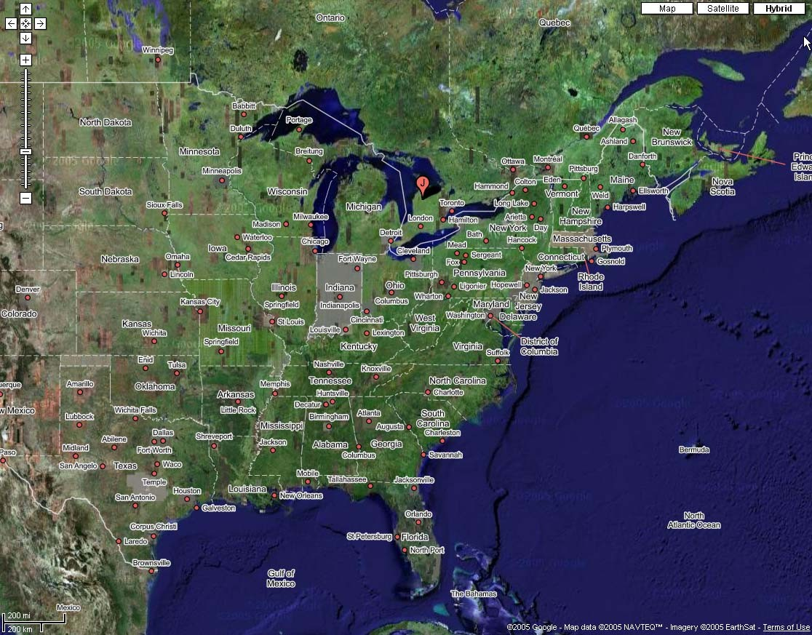
Walkerton, Ontario
Auton Lab Walkerton Analysis. Proprietary Information. www.autonlab.org
1

Slide 3
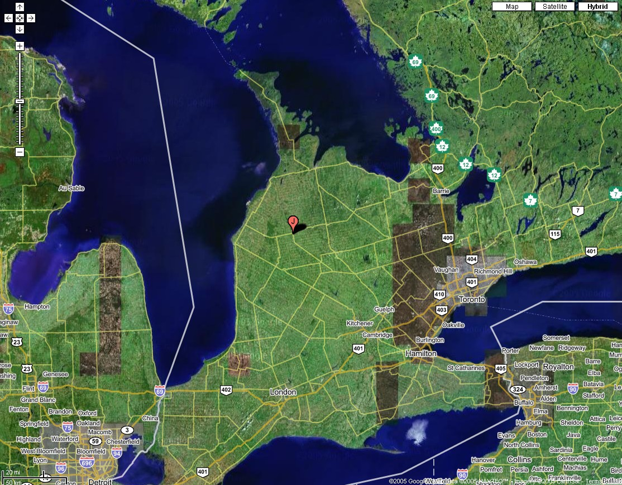
Walkerton, Ontario
Auton Lab Walkerton Analysis. Proprietary Information. www.autonlab.org
1

Slide 4
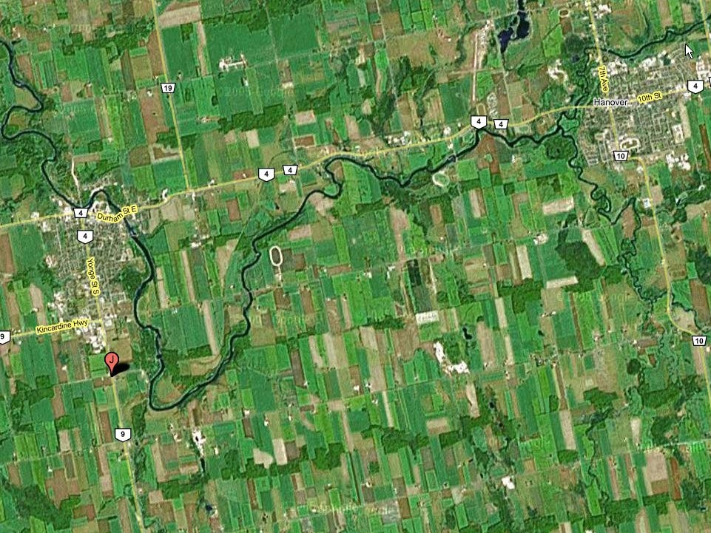
Hanover, Ontario
Walkerton, Ontario
4
Auton Lab Walkerton Analysis. Proprietary Information. www.autonlab.org

Slide 5
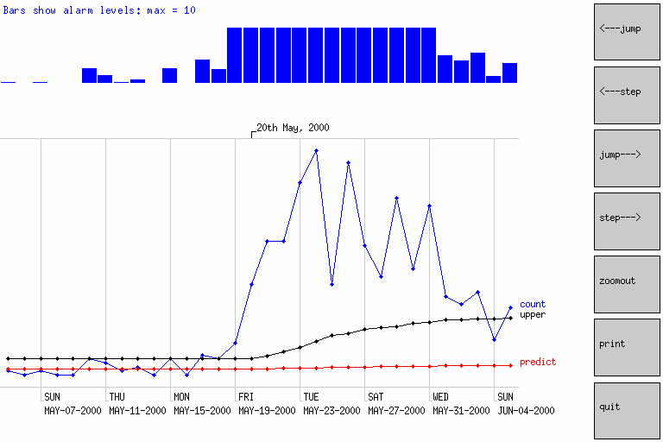
Data | Tracking | Method
3 year data (excludes Hanover) | GI visits from city of Walkerton | Standard Control Chart
Auton Lab Walkerton Analysis. Proprietary Information. www.autonlab.org

Slide 6
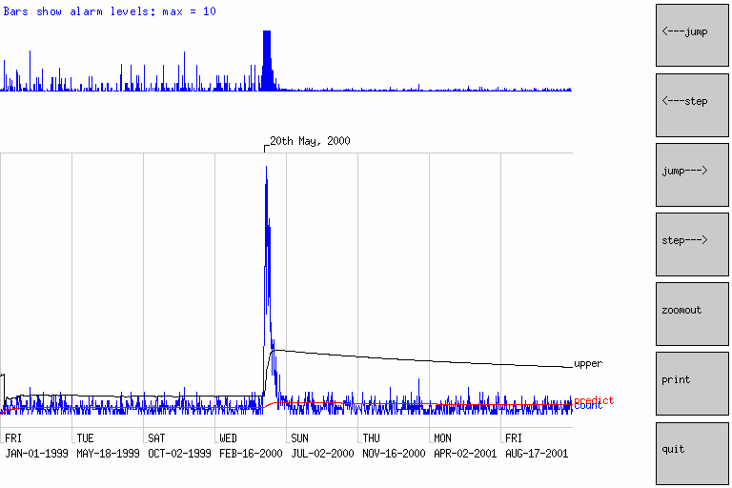
Data | Tracking | Method
3 year data (excludes Hanover) | GI visits from city of Walkerton | Standard Control Chart
Auton Lab Walkerton Analysis. Proprietary Information. www.autonlab.org

Slide 7
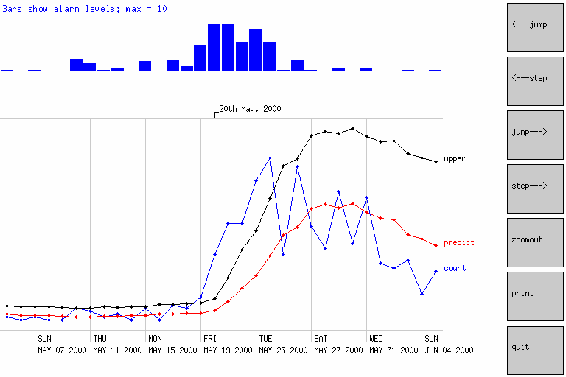
Data | Tracking | Method
3 year data (excludes Hanover) | GI visits from city of Walkerton | Moving Average (7 days)
Auton Lab Walkerton Analysis. Proprietary Information. www.autonlab.org

Slide 8
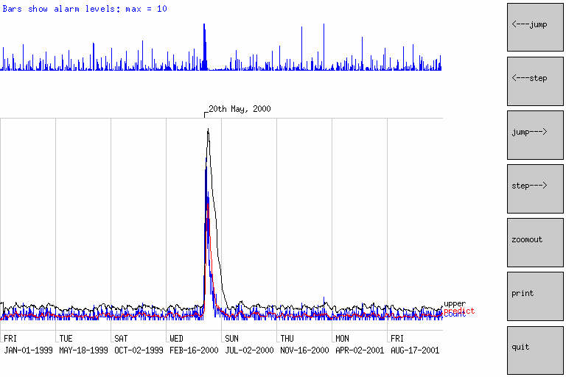
Data | Tracking | Method
3 year data (excludes Hanover) | GI visits from city of Walkerton | Moving Average (7 days)
Auton Lab Walkerton Analysis. Proprietary Information. www.autonlab.org

Slide 9
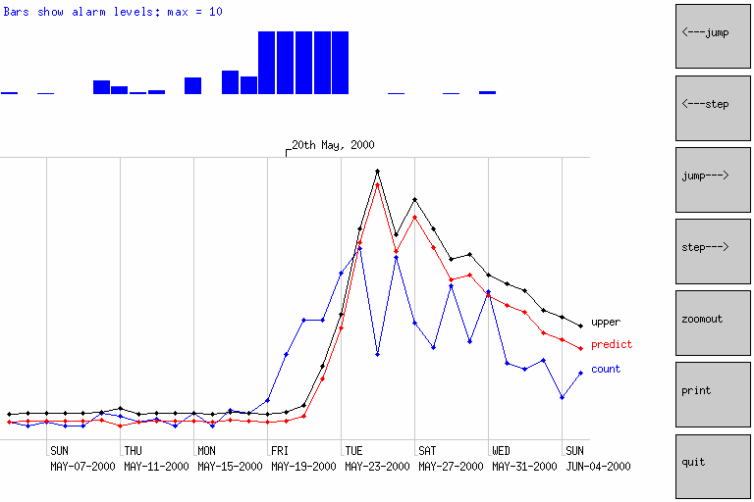
Data | Tracking | Method
3 year data (excludes Hanover) | GI visits from city of Walkerton | Regression w/ DOW + Season
Auton Lab Walkerton Analysis. Proprietary Information. www.autonlab.org

Slide 10
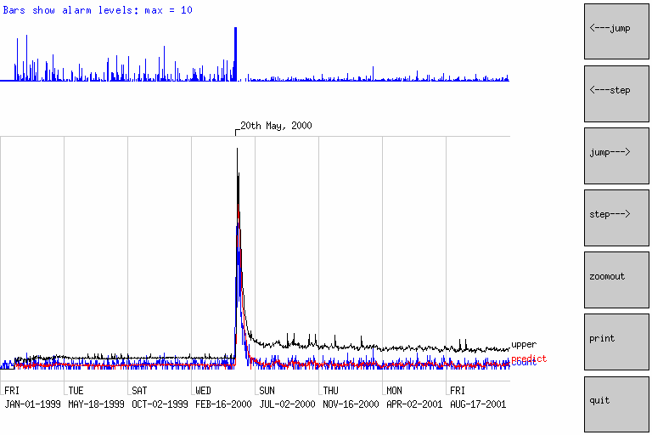
Data | Tracking | Method
3 year data (excludes Hanover) | GI visits from city of Walkerton | Regression w/ DOW + Season
Auton Lab Walkerton Analysis. Proprietary Information. www.autonlab.org

Slide 11
Performance of Univariate Algorithms: May 20th 2000
Data | Tracking
3 year data (excludes Hanover) | GI visits from city of Walkerton
(False Positive Rate = Fraction of the days outside interval May 5-June 15 2000 in which there would have been an alarm, if the threshold was set such that the given date was detected)
cc | 0.0% | Standard Control Chart
ma1 | 0.0% | Yesterday
ma3 | 0.0% | Moving Average (3-day window)
ma7 | 0.1% | Moving Average (7-day window)
ma14 | 0.1% | Moving Average (14-day window)
ma28 | 0.1% | Moving Average (28-day window)
regh | 0.0% | Regression (Hours of Daylight)
regm | 0.0% | Regression (HOD + Monday)
regtu | 0.1% | Regression | (HOD | + | Monday | + Tuesday)
regth | 0.1% | Regression | (HOD | + | Monday | + ... Thursday + | Mean of Last Week)
regs | 0.0% | Regression | (HOD | + | Monday | + ... Saturday + | Mean of Last Week)
regs84 | 0.1% | Regression | HOD | + | M..S + | LastWeek learning | from last 3 months
regs28 | 0.8% | Regression | HOD | + | M..S + | LastWeek learning | from last 4 weeks
regsh | 0.0% | Regression | HOD | + | M..S + | LastWeek avoiding | times near holidays
cusum1 | 0.0% | CUSUM With | H = | 1
cusum2 | 0.0% | CUSUM With | H = | 2
cusum5 | 1.0% | CUSUM With | H = | 5
cusum10 | 1.4% | CUSUM With | H = | 10
cusum20 | 4.1% | CUSUM With | H = | 20
sa1 | 0.3% | Sickness/Availability | with | Window | of | 1 | day
sa3 | 0.4% | Sickness/Availability | with | Window | of | 3 | days
sa7 | 0.5% | Sickness/Availability | with | Window | of | 7 | days
sa14
0.5% Sickness/Availability with Window of 14 days
sa28
0.5% Sickness/Availability with Window of 28 days
Auton Lab Walkerton Analysis. Proprietary Information. www.autonlab.org

Slide 12
Performance of Univariate Algorithms: May 19th 2000
Data | Tracking
3 year data (excludes Hanover) | GI visits from city of Walkerton
(False Positive Rate = Fraction of the days outside interval May 5-June 15 2000 in which there would have been an alarm, if the threshold was set such that the given date was detected)
cc | 0.0% | Standard Control Chart
ma1 | 2.1% | Yesterday
ma3 | 2.3% | Moving Average (3-day window)
ma7 | 0.8% | Moving Average (7-day window)
ma14 | 0.3% | Moving Average (14-day window)
ma28 | 0.5% | Moving Average (28-day window)
regh | 0.0% | Regression (Hours of Daylight)
regm | 0.0% | Regression (HOD + Monday)
regtu | 0.1% | Regression | (HOD | + | Monday | + Tuesday)
regth | 0.1% | Regression | (HOD | + | Monday | + ... Thursday + | Mean of Last Week)
regs | 0.0% | Regression | (HOD | + | Monday | + ... Saturday + | Mean of Last Week)
regs84 | 0.1% | Regression | HOD | + | M..S + | LastWeek learning | from last 3 months
regs28 | 0.8% | Regression | HOD | + | M..S + | LastWeek learning | from last 4 weeks
regsh | 0.0% | Regression | HOD | + | M..S + | LastWeek avoiding | times near holidays
cusum1 | 0.2% | CUSUM With | H = | 1
cusum2 | 0.0% | CUSUM With | H = | 2
cusum5 | 4.4% | CUSUM With | H = | 5
cusum10 | 1.6% | CUSUM With | H = | 10
cusum20 | 1.4% | CUSUM With | H = | 20
sa1 | 0.3% | Sickness/Availability | with | Window | of | 1 | day
sa3 | 0.4% | Sickness/Availability | with | Window | of | 3 | days
sa7 | 0.5% | Sickness/Availability | with | Window | of | 7 | days
sa14
0.5% Sickness/Availability with Window of 14 days
sa28
0.5% Sickness/Availability with Window of 28 days
Auton Lab Walkerton Analysis. Proprietary Information. www.autonlab.org

Slide 13
Performance of Univariate Algorithms: May 18th 2000
Data | Tracking
3 year data (excludes Hanover) | GI visits from city of Walkerton
(False Positive Rate = Fraction of the days outside interval May 5-June 15 2000 in which there would have been an alarm, if the threshold was set such that the given date was detected)
cc | 2.7% | Standard Control Chart
ma1 | 72.5% | Yesterday
ma3 | 27.7% | Moving Average (3-day window)
ma7 | 14.9% | Moving Average (7-day window)
ma14 | 11.2% | Moving Average (14-day window)
ma28 | 13.1% | Moving Average (28-day window)
regh | 2.5% | Regression (Hours of Daylight)
regm | 2.6% | Regression (HOD + Monday)
regtu | 2.7% | Regression | (HOD | + | Monday | + Tuesday)
regth | 2.5% | Regression | (HOD | + | Monday | + ... Thursday + | Mean of Last Week)
regs | 2.8% | Regression | (HOD | + | Monday | + ... Saturday + | Mean of Last Week)
regs84 | 7.4% | Regression | HOD | + | M..S + | LastWeek learning | from last 3 months
regs28 | 2.8% | Regression | HOD | + | M..S + | LastWeek learning | from last 4 weeks
regsh | 2.6% | Regression | HOD | + | M..S + | LastWeek avoiding | times near holidays
cusum1 | 7.2% | CUSUM With | H = | 1
cusum2 | 11.2% | CUSUM With | H = | 2
cusum5 | 2.0% | CUSUM With | H = | 5
cusum10 | 2.4% | CUSUM With | H = | 10
cusum20 | 1.6% | CUSUM With | H = | 20
sa1 | 29.0% | Sickness/Availability | with | Window | of | 1 | day
sa3 | 20.3% | Sickness/Availability | with | Window | of | 3 | days
sa7 | 15.2% | Sickness/Availability | with | Window | of | 7 | days
sa14
9.4% Sickness/Availability with Window of 14 days
sa28
12.1% Sickness/Availability with Window of 28 days
Auton Lab Walkerton Analysis. Proprietary Information. www.autonlab.org

Slide 14
Performance of Univariate Algorithms: May 17th 2000
Data | Tracking
3 year data (excludes Hanover) | GI visits from city of Walkerton
(False Positive Rate = Fraction of the days outside interval May 5-June 15 2000 in which there would have been an alarm, if the threshold was set such that the given date was detected)
cc | 1.0% | Standard Control Chart
ma1 | 0.7% | Yesterday
ma3 | 5.1% | Moving Average (3-day window)
ma7 | 6.7% | Moving Average (7-day window)
ma14 | 3.9% | Moving Average (14-day window)
ma28 | 4.6% | Moving Average (28-day window)
regh | 0.8% | Regression (Hours of Daylight)
regm | 0.7% | Regression (HOD + Monday)
regtu | 0.8% | Regression | (HOD | + | Monday | + Tuesday)
regth | 1.2% | Regression | (HOD | + | Monday | + ... Thursday + | Mean of Last Week)
regs | 1.4% | Regression | (HOD | + | Monday | + ... Saturday + | Mean of Last Week)
regs84 | 6.5% | Regression | HOD | + | M..S + | LastWeek learning | from last 3 months
regs28 | 14.7% | Regression | HOD | + | M..S + | LastWeek learning | from last 4 weeks
regsh | 1.2% | Regression | HOD | + | M..S + | LastWeek avoiding | times near holidays
cusum1 | 2.3% | CUSUM With | H = | 1
cusum2 | 1.7% | CUSUM With | H = | 2
cusum5 | 4.4% | CUSUM With | H = | 5
cusum10 | 5.3% | CUSUM With | H = | 10
cusum20 | 3.2% | CUSUM With | H = | 20
sa1 5.4% Sickness/Availability with Window of 1 day
sa3
sa7 sa14
16.3%
21.1%
15.8%
Sickness/Availability
Sickness/Availability Sickness/Availability
with
with with with
Window
Window Window Window
of
of of of
3 days
7 days
14 days
28 days28
sa28
17.7%
Sickness/Availability
Auton Lab Walkerton Analysis. Proprietary Information. www.autonlab.org

Slide 15
Performance of Univariate Algorithms: May 16th 2000
Data | Tracking
3 year data (excludes Hanover) | GI visits from city of Walkerton
(False Positive Rate = Fraction of the days outside interval May 5-June 15 2000 in which there would have been an alarm, if the threshold was set such that the given date was detected)
cc | 97.9% | Standard Control Chart
ma1 | 98.3% | Yesterday
ma3 | 87.1% | Moving Average (3-day window)
ma7 | 91.2% | Moving Average (7-day window)
ma14 | 83.0% | Moving Average (14-day window)
ma28 | 88.2% | Moving Average (28-day window)
regh | 94.3% | Regression (Hours of Daylight)
regm | 93.2% | Regression (HOD + Monday)
regtu | 90.9% | Regression | (HOD | + | Monday | + Tuesday)
regth | 89.7% | Regression | (HOD | + | Monday | + ... Thursday + | Mean of Last Week)
regs | 91.1% | Regression | (HOD | + | Monday | + ... Saturday + | Mean of Last Week)
regs84 | 85.4% | Regression | HOD | + | M..S + | LastWeek learning | from last 3 months
regs28 | 53.1% | Regression | HOD | + | M..S + | LastWeek learning | from last 4 weeks
regsh | 91.9% | Regression | HOD | + | M..S + | LastWeek avoiding | times near holidays
cusum1 | 100.0% | CUSUM With | H = | 1
cusum2 | 29.2% | CUSUM With | H = | 2
cusum5 | 23.4% | CUSUM With | H = | 5
cusum10 | 15.3% | CUSUM With | H = | 10
cusum20 | 8.5% | CUSUM With | H = | 20
sa1 | 97.3% | Sickness/Availability | with | Window | of | 1 | day
sa3 | 92.9% | Sickness/Availability | with | Window | of | 3 | days
sa7 | 94.6% | Sickness/Availability | with | Window | of | 7 | days
sa14
87.7% Sickness/Availability with Window of 14 days
sa28
95.6% Sickness/Availability with Window of 28 days
15
Auton Lab Walkerton Analysis. Proprietary Information. www.autonlab.org

Slide 16
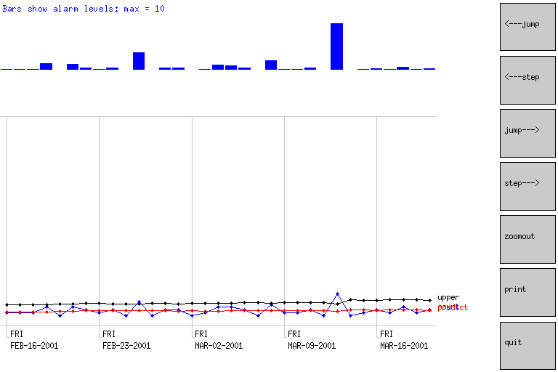
The biggest Walkerton GI blip outside the outbreak period
Auton Lab Walkerton Analysis. Proprietary Information. www.autonlab.org

Slide 17
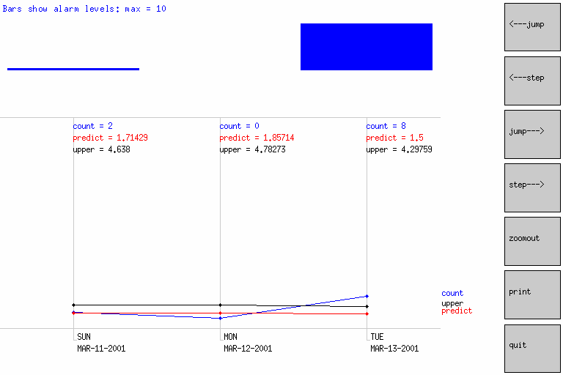
The biggest Walkerton GI blip outside the outbreak period
Auton Lab Walkerton Analysis. Proprietary Information. www.autonlab.org

Slide 18
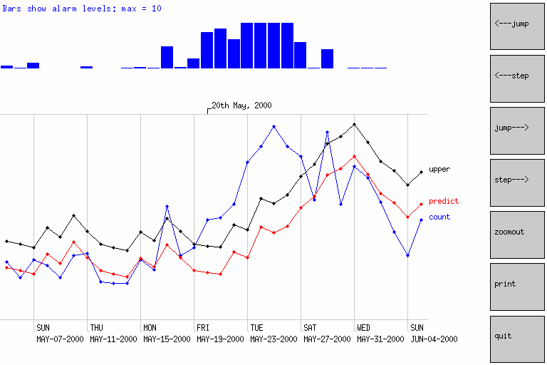
Data | Tracking | Method
3 year data (excludes Hanover) | Walkerton visits (all patients from Walkerton) | Regression w/ DOW + Season
Auton Lab Walkerton Analysis. Proprietary Information. www.autonlab.org

Slide 19
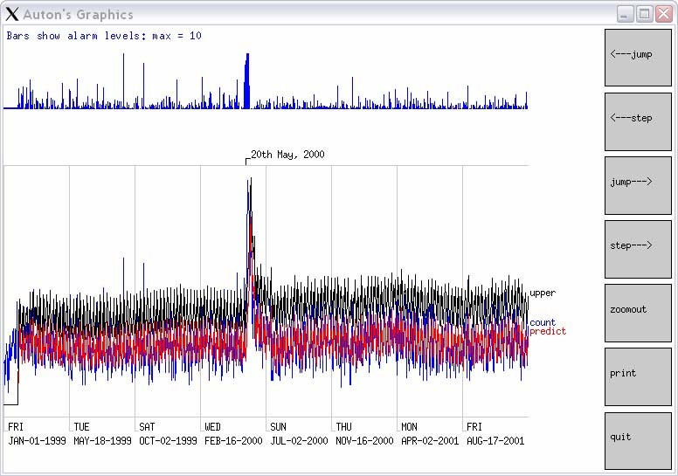
Data | Tracking | Method
3 year data (excludes Hanover) | Walkerton visits (all patients from Walkerton) | Regression w/ DOW + Season
Auton Lab Walkerton Analysis. Proprietary Information. www.autonlab.org

Slide 20
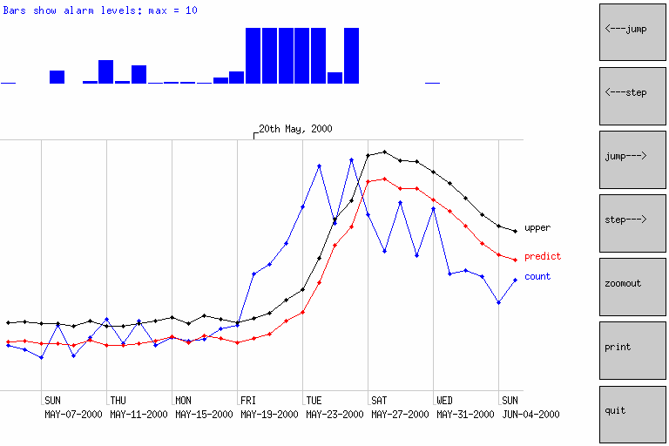
Data | Tracking | Method
3 year data (excludes Hanover) | GI visits from everywhere | Regression w/ DOW + Season
Auton Lab Walkerton Analysis. Proprietary Information. www.autonlab.org

Slide 21
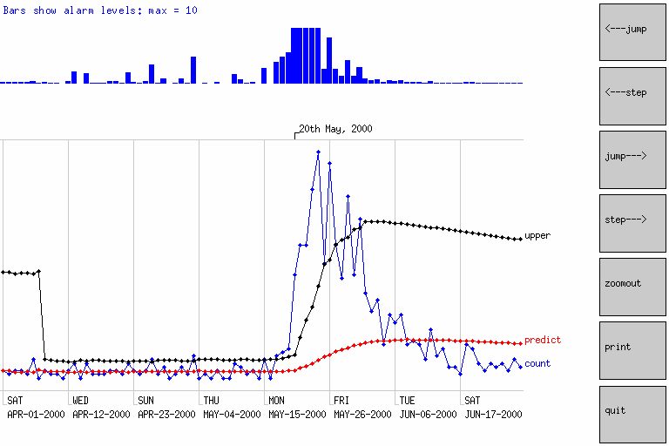
Data | Tracking | Method
3 month data (includes Hanover) | GI visits from city of Walkerton | Standard Control Chart
Auton Lab Walkerton Analysis. Proprietary Information. www.autonlab.org

Slide 22
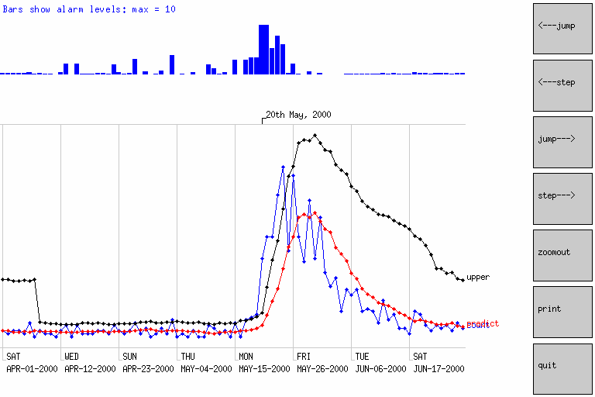
Data | Tracking | Method
3 month data (includes Hanover) | GI visits from city of Walkerton | Moving Average (7 days)
Auton Lab Walkerton Analysis. Proprietary Information. www.autonlab.org

Slide 23
Performance of Univariate Algorithms: May 20th 2000
Data | Tracking
3 month data (includes Hanover) | GI visits from city of Walkerton
(False Positive Rate = Fraction of the days outside interval May 5-June 15 2000 in which there would have been an alarm, if the threshold was set such that the given date was detected)
cc | 0.0% | Standard Control Chart
ma1 | 0.0% | Yesterday
ma3 | 0.0% | Moving Average (3-day window)
ma7 | 0.0% | Moving Average (7-day window)
ma14 | 0.0% | Moving Average (14-day window)
ma28 | 0.0% | Moving Average (28-day window)
regh | 0.0% | Regression (Hours of Daylight)
regm | 0.0% | Regression (HOD + Monday)
regtu | 0.0% | Regression | (HOD | + | Monday | + Tuesday)
regth | 0.0% | Regression | (HOD | + | Monday | + ... Thursday + | Mean of Last Week)
regs | 0.0% | Regression | (HOD | + | Monday | + ... Saturday + | Mean of Last Week)
regs84 | 0.0% | Regression | HOD | + | M..S + | LastWeek learning | from last 3 months
regs28 | 0.0% | Regression | HOD | + | M..S + | LastWeek learning | from last 4 weeks
regsh | 0.0% | Regression | HOD | + | M..S + | LastWeek avoiding | times near holidays
cusum1 | 100.0% | CUSUM With | H = | 1
cusum2 | 100.0% | CUSUM With | H = | 2
cusum5 | 100.0% | CUSUM With | H = | 5
cusum10 | 100.0% | CUSUM With | H = | 10
cusum20 | 100.0% | CUSUM With | H = | 20
sa1 | 1.8% | Sickness/Availability | with | Window | of | 1 | day
sa3 | 1.8% | Sickness/Availability | with | Window | of | 3 | days
sa7 | 1.8% | Sickness/Availability | with | Window | of | 7 | days
sa14
3.5% Sickness/Availability with Window of 14 days
sa28
3.5% Sickness/Availability with Window of 28 days
Auton Lab Walkerton Analysis. Proprietary Information. www.autonlab.org

Slide 24
Performance of Univariate Algorithms: May 19th 2000
Data | Tracking
3 month data (includes Hanover) | GI visits from city of Walkerton
(False Positive Rate = Fraction of the days outside interval May 5-June 15 2000 in which there would have been an alarm, if the threshold was set such that the given date was detected)
cc | 0.0% | Standard Control Chart
ma1 | 31.6% | Yesterday
ma3 | 5.3% | Moving Average (3-day window)
ma7 | 1.8% | Moving Average (7-day window)
ma14 | 0.0% | Moving Average (14-day window)
ma28 | 1.8% | Moving Average (28-day window)
regh | 0.0% | Regression (Hours of Daylight)
regm | 0.0% | Regression (HOD + Monday)
regtu | 0.0% | Regression | (HOD | + | Monday | + Tuesday)
regth | 0.0% | Regression | (HOD | + | Monday | + ... Thursday + | Mean of Last Week)
regs | 0.0% | Regression | (HOD | + | Monday | + ... Saturday + | Mean of Last Week)
regs84 | 0.0% | Regression | HOD | + | M..S + | LastWeek learning | from last 3 months
regs28 | 0.0% | Regression | HOD | + | M..S + | LastWeek learning | from last 4 weeks
regsh | 0.0% | Regression | HOD | + | M..S + | LastWeek avoiding | times near holidays
cusum1 | 100.0% | CUSUM With | H = | 1
cusum2 | 100.0% | CUSUM With | H = | 2
cusum5 | 100.0% | CUSUM With | H = | 5
cusum10 | 100.0% | CUSUM With | H = | 10
cusum20 | 100.0% | CUSUM With | H = | 20
sa1 | 1.8% | Sickness/Availability | with | Window | of | 1 | day
sa3 | 1.8% | Sickness/Availability | with | Window | of | 3 | days
sa7 | 1.8% | Sickness/Availability | with | Window | of | 7 | days
sa14
3.5% Sickness/Availability with Window of 14 days
sa28
3.5% Sickness/Availability with Window of 28 days
Auton Lab Walkerton Analysis. Proprietary Information. www.autonlab.org

Slide 25
Performance of Univariate Algorithms: May 18th 2000
Data | Tracking
3 month data (includes Hanover) | GI visits from city of Walkerton
(False Positive Rate = Fraction of the days outside interval May 5-June 15 2000 in which there would have been an alarm, if the threshold was set such that the given date was detected)
cc | 0.0% | Standard Control Chart
ma1 | 31.6% | Yesterday
ma3 | 7.0% | Moving Average (3-day window)
ma7 | 1.8% | Moving Average (7-day window)
ma14 | 0.0% | Moving Average (14-day window)
ma28 | 1.8% | Moving Average (28-day window)
regh | 1.8% | Regression (Hours of Daylight)
regm | 1.8% | Regression (HOD + Monday)
regtu | 1.8% | Regression | (HOD | + | Monday | + Tuesday)
regth | 0.0% | Regression | (HOD | + | Monday | + ... Thursday + | Mean of Last Week)
regs | 0.0% | Regression | (HOD | + | Monday | + ... Saturday + | Mean of Last Week)
regs84 | 0.0% | Regression | HOD | + | M..S + | LastWeek learning | from last 3 months
regs28 | 0.0% | Regression | HOD | + | M..S + | LastWeek learning | from last 4 weeks
regsh | 0.0% | Regression | HOD | + | M..S + | LastWeek avoiding | times near holidays
cusum1 | 100.0% | CUSUM With | H = | 1
cusum2 | 100.0% | CUSUM With | H = | 2
cusum5 | 100.0% | CUSUM With | H = | 5
cusum10 | 100.0% | CUSUM With | H = | 10
cusum20 | 100.0% | CUSUM With | H = | 20
sa1 | 7.0% | Sickness/Availability | with | Window | of | 1 | day
sa3 | 5.3% | Sickness/Availability | with | Window | of | 3 | days
sa7 | 3.5% | Sickness/Availability | with | Window | of | 7 | days
sa14
3.5% Sickness/Availability with Window of 14 days
sa28
5.3% Sickness/Availability with Window of 28 days
Auton Lab Walkerton Analysis. Proprietary Information. www.autonlab.org

Slide 26
Performance of Univariate Algorithms: May 17th 2000
Data | Tracking
3 month data (includes Hanover) | GI visits from city of Walkerton
(False Positive Rate = Fraction of the days outside interval May 5-June 15 2000 in which there would have been an alarm, if the threshold was set such that the given date was detected)
cc | 1.8% | Standard Control Chart
ma1 | 0.0% | Yesterday
ma3 | 3.5% | Moving Average (3-day window)
ma7 | 3.5% | Moving Average (7-day window)
ma14 | 1.8% | Moving Average (14-day window)
ma28 | 1.8% | Moving Average (28-day window)
regh | 1.8% | Regression (Hours of Daylight)
regm | 1.8% | Regression (HOD + Monday)
regtu | 1.8% | Regression | (HOD | + | Monday | + Tuesday)
regth | 1.8% | Regression | (HOD | + | Monday | + ... Thursday + | Mean of Last Week)
regs | 1.8% | Regression | (HOD | + | Monday | + ... Saturday + | Mean of Last Week)
regs84 | 1.8% | Regression | HOD | + | M..S + | LastWeek learning | from last 3 months
regs28 | 1.8% | Regression | HOD | + | M..S + | LastWeek learning | from last 4 weeks
regsh | 1.8% | Regression | HOD | + | M..S + | LastWeek avoiding | times near holidays
cusum1 | 100.0% | CUSUM With | H = | 1
cusum2 | 100.0% | CUSUM With | H = | 2
cusum5 | 100.0% | CUSUM With | H = | 5
cusum10 | 100.0% | CUSUM With | H = | 10
cusum20 | 100.0% | CUSUM With | H = | 20
sa1 | 3.5% | Sickness/Availability | with | Window | of | 1 | day
sa3 | 3.5% | Sickness/Availability | with | Window | of | 3 | days
sa7 | 5.3% | Sickness/Availability | with | Window | of | 7 | days
sa14
7.0% Sickness/Availability with Window of 14 days
sa28
7.0% Sickness/Availability with Window of 28 days
26
Auton Lab Walkerton Analysis. Proprietary Information. www.autonlab.org

Slide 27
Performance of Univariate Algorithms: May 16th 2000
Data | Tracking
3 month data (includes Hanover) | GI visits from city of Walkerton
(False Positive Rate = Fraction of the days outside interval May 5-June 15 2000 in which there would have been an alarm, if the threshold was set such that the given date was detected)
cc | 93.0% | Standard Control Chart
ma1 | 98.2% | Yesterday
ma3 | 94.7% | Moving Average (3-day window)
ma7 | 94.7% | Moving Average (7-day window)
ma14 | 93.0% | Moving Average (14-day window)
ma28 | 93.0% | Moving Average (28-day window)
regh | 77.2% | Regression (Hours of Daylight)
regm | 78.9% | Regression (HOD + Monday)
regtu | 57.9% | Regression | (HOD | + | Monday | + Tuesday)
regth | 86.0% | Regression | (HOD | + | Monday | + ... Thursday + | Mean of Last Week)
regs | 86.0% | Regression | (HOD | + | Monday | + ... Saturday + | Mean of Last Week)
regs84 | 86.0% | Regression | HOD | + | M..S + | LastWeek learning | from last 3 months
regs28 | 89.5% | Regression | HOD | + | M..S + | LastWeek learning | from last 4 weeks
regsh | 86.0% | Regression | HOD | + | M..S + | LastWeek avoiding | times near holidays
cusum1 | 100.0% | CUSUM With | H = | 1
cusum2 | 100.0% | CUSUM With | H = | 2
cusum5 | 100.0% | CUSUM With | H = | 5
cusum10 | 100.0% | CUSUM With | H = | 10
cusum20 | 100.0% | CUSUM With | H = | 20
sa1 | 98.2% | Sickness/Availability | with | Window | of | 1 | day
sa3 | 98.2% | Sickness/Availability | with | Window | of | 3 | days
sa7 | 98.2% | Sickness/Availability | with | Window | of | 7 | days
sa14 100.0% Sickness/Availability with Window of 14 days
sa28
80.7% Sickness/Availability with Window of 28 days
27
Auton Lab Walkerton Analysis. Proprietary Information. www.autonlab.org

Slide 28
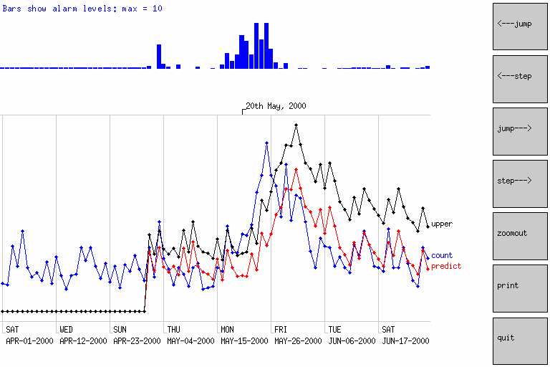
Data | Tracking | Method
3 month data (includes Hanover) | Walkerton visits (all patients from Walkerton) | Regression w/ DOW + Season
Auton Lab Walkerton Analysis. Proprietary Information. www.autonlab.org

Slide 29
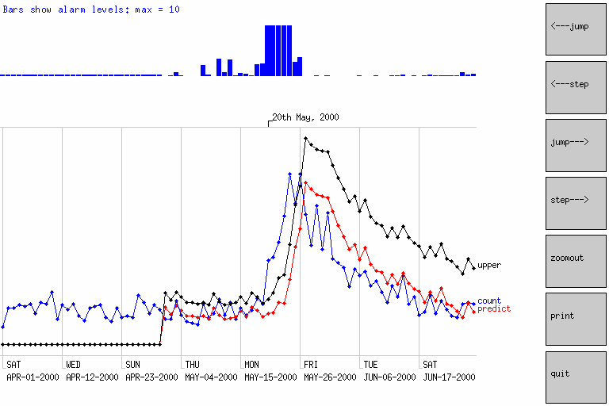
Data | Tracking | Method
3 month data (includes Hanover) | GI visits from everywhere | Regression w/ DOW + Season
Auton Lab Walkerton Analysis. Proprietary Information. www.autonlab.org

Slide 30
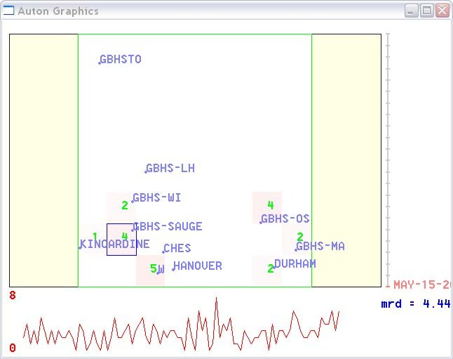
Spatial Scan: Hospital
Data | Tracking | Method
3 year data (excludes Hanover) | GI visits from everywhere | Fast Spatial Scan on Hospital Long/Latitude
Auton Lab Walkerton Analysis. Proprietary Information. www.autonlab.org

Slide 31
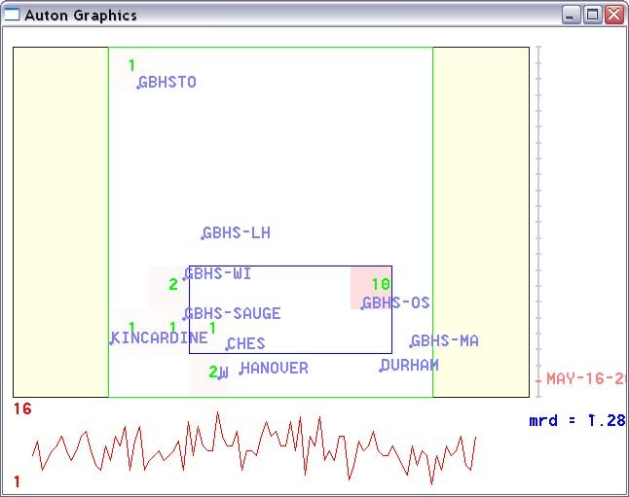
Spatial Scan: Hospital
Data | Tracking | Method
3 year data (excludes Hanover) | GI visits from everywhere | Fast Spatial Scan on Hospital Long/Latitude
Auton Lab Walkerton Analysis. Proprietary Information. www.autonlab.org

Slide 32
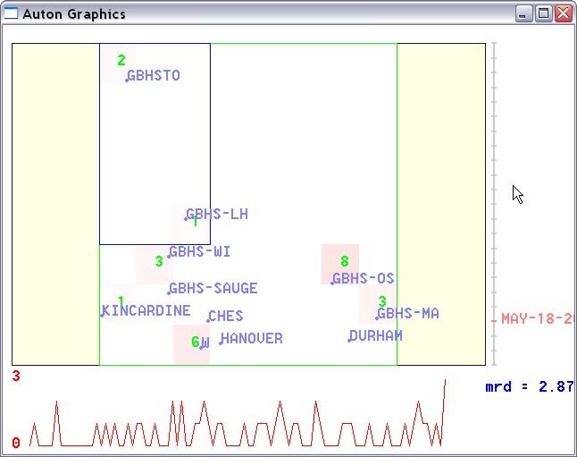
Spatial Scan: Hospital
Data | Tracking | Method
3 year data (excludes Hanover) | GI visits from everywhere | Fast Spatial Scan on Hospital Long/Latitude
Auton Lab Walkerton Analysis. Proprietary Information. www.autonlab.org

Slide 33
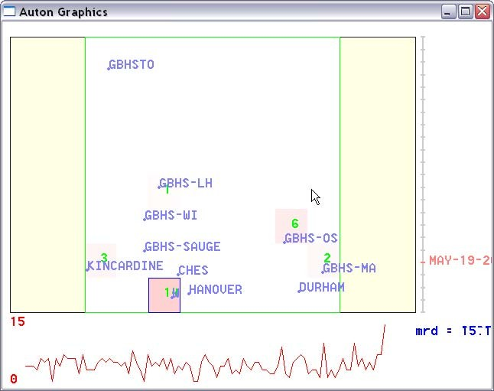
Spatial Scan: Hospital
Data | Tracking | Method
3 year data (excludes Hanover) | GI visits from everywhere | Fast Spatial Scan on Hospital Long/Latitude
Auton Lab Walkerton Analysis. Proprietary Information. www.autonlab.org

Slide 34
Spatial Scan: Hospital
Data | Tracking | Method
3 year data (excludes Hanover) | GI visits from everywhere | Fast Spatial Scan on Hospital Long/Latitude
Spatial scan is very impressed on May 19th
Auton Lab Walkerton Analysis. Proprietary Information. www.autonlab.org

Slide 35
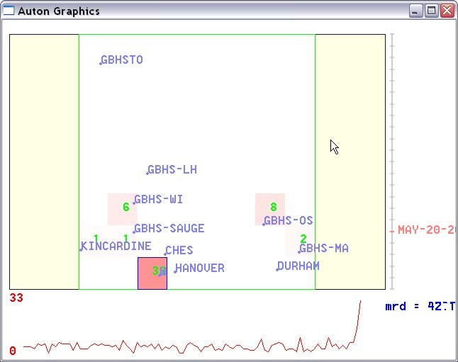
Spatial Scan: Hospital
Data | Tracking | Method
3 year data (excludes Hanover) | GI visits from everywhere | Fast Spatial Scan on Hospital Long/Latitude
Auton Lab Walkerton Analysis. Proprietary Information. www.autonlab.org

Slide 36
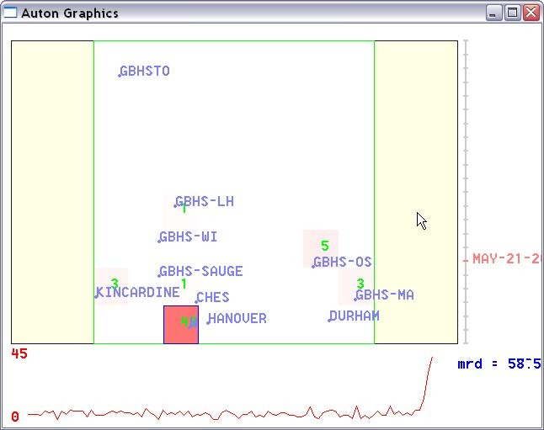
Spatial Scan: Hospital
Data | Tracking | Method
3 year data (excludes Hanover) | GI visits from everywhere | Fast Spatial Scan on Hospital Long/Latitude
Auton Lab Walkerton Analysis. Proprietary Information. www.autonlab.org

Slide 37
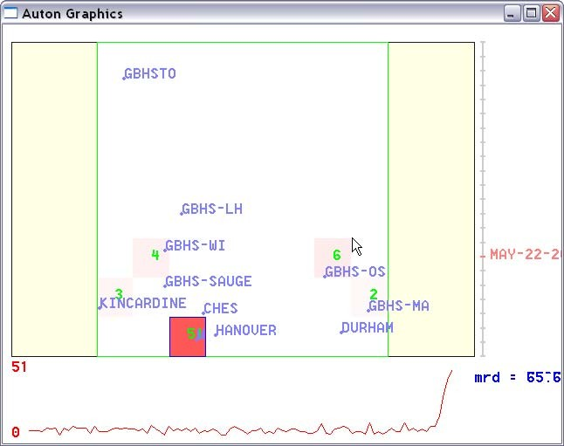
Spatial Scan: Hospital
Data | Tracking | Method
3 year data (excludes Hanover) | GI visits from everywhere | Fast Spatial Scan on Hospital Long/Latitude
Auton Lab Walkerton Analysis. Proprietary Information. www.autonlab.org

Slide 38
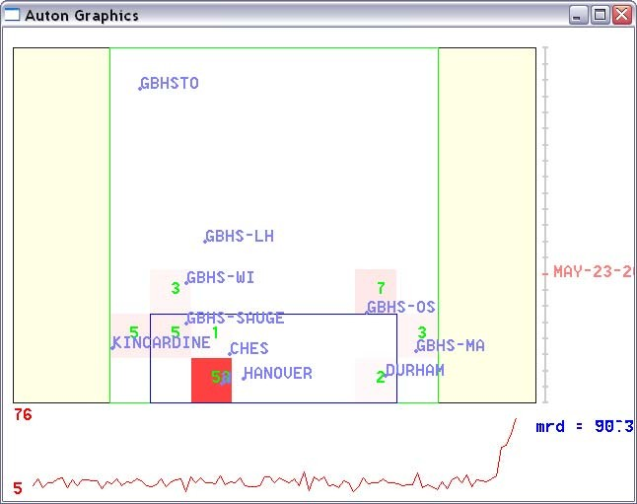
Spatial Scan: Hospital
Data | Tracking | Method
3 year data (excludes Hanover) | GI visits from everywhere | Fast Spatial Scan on Hospital Long/Latitude
Auton Lab Walkerton Analysis. Proprietary Information. www.autonlab.org

Slide 39
Spatial Scan: Hospital
Data | Tracking | Method
3 year data (excludes Hanover) | GI visits from everywhere | Fast Spatial Scan on Hospital Long/Latitude
Total number of non-attack days: 990
Method/Date | 05/18/00 | 05/19/00 | 05/20/00 | 05/21/00
all_mean_1 | 210 | 7 | 0 | 0
all_mean_3 | 416 | 10 | 0 | 0
adj_EWLR_1 | 230 | 4 | 0 | 0
adj_EWLR_3 | 489 | 27 | 0 | 0
adj_EWMA_1 | 203 | 1 | 0 | 0
adj_EWMA_3 | 412 | 2 | 0 | 0
strat_mean_1 | 302 | 6 | 0 | 0
strat_mean_3 | 526 | 15 | 0 | 0
Auton Lab Walkerton Analysis. Proprietary Information. www.autonlab.org

Slide 40
Spatial Scan: Hospital
Data | Tracking | Method
3 year data (excludes Hanover) | GI visits from everywhere | Fast Spatial Scan on Hospital Long/Latitude
Total number of non-attack days: 990
Method/Date | 05/18/00 | 05/19/00 | 05/20/00 | 05/21/00
all_mean_1 | 210 | 7 | 0 | 0
all_mean_3 | 416 | 10 | 0 | 0
adj_EWLR_1 | 230 | 4 | 0 | 0
adj_EWLR_3 | 489 | 27 | 0 | 0
adj_EWMA_1 | 203 | 1 | 0 | 0
adj_EWMA_3 | 412 | 2 | 0 | 0
strat_mean_1 | 302 | 6 | 0 | 0
strat_mean_3 | 526 | 15 | 0 | 0
we tested many variants of spatial scan, listed (with cryptic names) in the first column
Column 2 shows that if you set your alarm threshold high enough that there’d be an alarm on May 18th, all methods would produce hundreds of additional alarms on other occasions throughout the three years.
Column 3 shows that detecting May 19th involves far fewer false alarms, especially for the EWMA models
Auton Lab Walkerton Analysis. Proprietary Information. www.autonlab.org

Slide 41
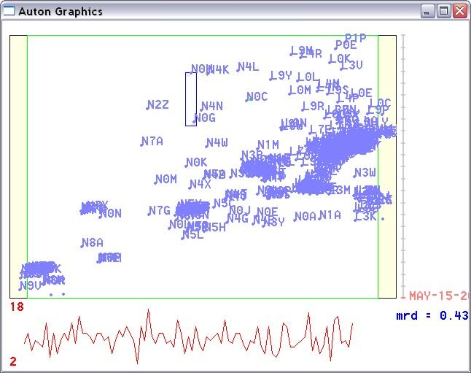
Spatial Scan: Home
Data | Tracking | Method
3 year data (excludes Hanover) | GI visits from everywhere | Fast Spatial Scan on Patient Home 3- character Postcode
Auton Lab Walkerton Analysis. Proprietary Information. www.autonlab.org

Slide 42
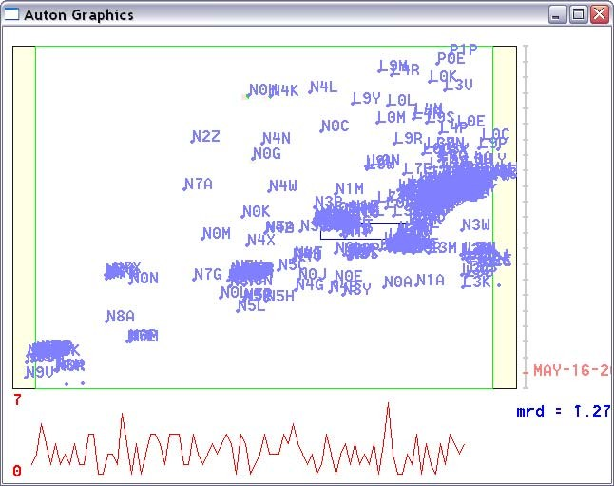
Spatial Scan: Home
Data | Tracking | Method
3 year data (excludes Hanover) | GI visits from everywhere | Fast Spatial Scan on Patient Home 3- character Postcode
Auton Lab Walkerton Analysis. Proprietary Information. www.autonlab.org

Slide 43
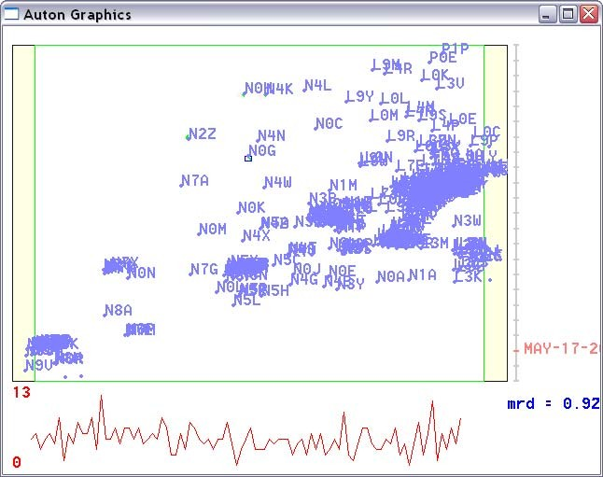
Spatial Scan: Home
Data | Tracking | Method
3 year data (excludes Hanover) | GI visits from everywhere | Fast Spatial Scan on Patient Home 3- character Postcode
Auton Lab Walkerton Analysis. Proprietary Information. www.autonlab.org

Slide 44
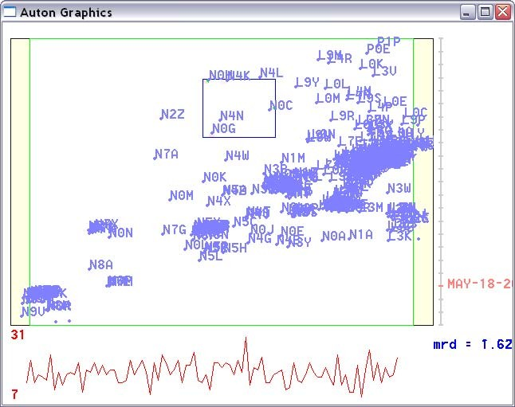
Spatial Scan: Home
Data | Tracking | Method
3 year data (excludes Hanover) | GI visits from everywhere | Fast Spatial Scan on Patient Home 3- character Postcode
Auton Lab Walkerton Analysis. Proprietary Information. www.autonlab.org

Slide 45

Spatial Scan: Home
Data | Tracking | Method
3 year data (excludes Hanover) | GI visits from everywhere | Fast Spatial Scan on Patient Home 3- character Postcode
Auton Lab Walkerton Analysis. Proprietary Information. www.autonlab.org

Slide 46
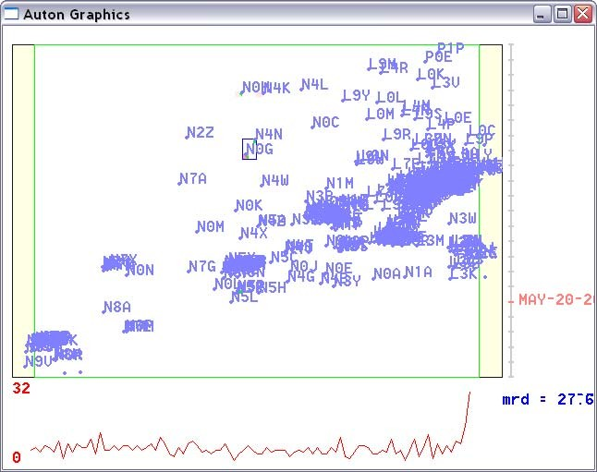
Spatial Scan: Home
Data | Tracking | Method
3 year data (excludes Hanover) | GI visits from everywhere | Fast Spatial Scan on Patient Home 3- character Postcode
Auton Lab Walkerton Analysis. Proprietary Information. www.autonlab.org

Slide 47

Spatial Scan: Home
Data | Tracking | Method
3 year data (excludes Hanover) | GI visits from everywhere | Fast Spatial Scan on Patient Home 3- character Postcode
Auton Lab Walkerton Analysis. Proprietary Information. www.autonlab.org

Slide 48

Spatial Scan: Home
Data | Tracking | Method
3 year data (excludes Hanover) | GI visits from everywhere | Fast Spatial Scan on Patient Home 3- character Postcode
Auton Lab Walkerton Analysis. Proprietary Information. www.autonlab.org

Slide 49
Spatial Scan: Home
Data | Tracking | Method
3 year data (excludes Hanover) | GI visits from everywhere | Fast Spatial Scan on Patient Home 3- character Postcode
Total number of non-attack days: 990
Method/Date | 05/18/00 | 05/19/00 | 05/20/00 | 05/21/00
all_mean_1 | 396 | 15 | 0 | 0
all_mean_3 | 583 | 25 | 0 | 0
adj_EWLR_1 | 351 | 6 | 1 | 0
adj_EWLR_3 | 696 | 30 | 6 | 0
adj_EWMA_1 | 390 | 2 | 0 | 0
adj_EWMA_3 | 685 | 8 | 0 | 0
strat_mean_1 | 438 | 3 | 0 | 0
strat_mean_3 | 738 | 11 | 0 | 0
Auton Lab Walkerton Analysis. Proprietary Information. www.autonlab.org

Slide 50
Now we imagine a vastly more general kind of monitoring. A method which is not told what sydrome, hospital, city or demographics to look for, but just to find anything that’s strange on each day and to assess accurately how significant this is.
The univariate methods were told what to watch (GI) and where (walkerton) The spatial methods were told what to watch (GI) but not where
The following method is meant to be a kind of safety net for entirely unanticipated things. There are papers about it on the auton lab website.
Auton Lab Walkerton Analysis. Proprietary Information. www.autonlab.org

Slide 51
WSARE
Data | Tracking | Method
3 year data (excludes Hanover) | All data from everywhere | What’s Strange About Recent Events
The most surprising thing about MAR-01-2000 is:
Normally 1.5% of records (20/1335) have sendng = CHES and syndrome = other But recently 10.0% of records (39/390) have sendng = CHES and syndrome = other Pvalue = 0.00099975
Which means that in a world where nothing changes we'd expect to have a result this significant about once every 1000 times we ran the program
Results 1-5 of the 14 days in 2000 in which WSARE issued an alert with a Pvalue exceeding 1 in 1000
9 of the 15 (shown in green) were during or just after the outbreak period
The most surprising thing about MAR-23-2000 is:
Normally 2.3% of records (28/1241) have sendng = CHES and syndrome = other But recently 9.6% of records (45/470) have sendng = CHES and syndrome = other Pvalue = 0.0005
Which means that in a world where nothing changes we'd expect to have a result this significant about once every 1999 times we ran the program
The most surprising thing about MAR-31-2000 is:
Normally 22.1% of records (270/1223) have sendng = GBHS-OS But recently 39.5% of records (96/243) have sendng = GBHS-OS Pvalue = 0.0005
Which means that in a world where nothing changes we'd expect to have a result this significant about once every 1999 times we ran the program
The most surprising thing about MAY-20-2000 is:
Normally 0.2% of records (2/1042) have city = WALKERTON and syndrome = gastrointestinal But recently 5.8% of records (23/396) have city = WALKERTON and syndrome = gastrointestinal Pvalue = 0.00099975
Which means that in a world where nothing changes we'd expect to have a result this significant about once every 1000 times we ran the program
The most surprising thing about MAY-21-2000 is:
Normally 0.8% of records (7/906) have sendng = W and syndrome = gastrointestinal But recently 10.2% of records (43/422) have sendng = W and syndrome = gastrointestinal Pvalue = 0.0005
Which means that in a world where nothing changes we'd expect to have a result this significant about once every 1999 times we ran the program
Auton Lab Walkerton Analysis. Proprietary Information. www.autonlab.org

Slide 52
WSARE
Data | Tracking | Method
3 year data (excludes Hanover) | All data from everywhere | What’s Strange About Recent Events
The most surprising thing about MAY-22-2000 is:
Normally 0.9% of records (12/1360) have sendng = W and syndrome = gastrointestinal But recently 11.6% of records (51/438) have sendng = W and syndrome = gastrointestinal Pvalue = 0.0005
Which means that in a world where nothing changes we'd expect to have a result this significant about once every 1999 times we ran the program
Results 6-10 of the 14 days in 2000 in which WSARE issued an alert with a Pvalue exceeding 1 in 1000
9 of the 15 (shown in green) were during or just after the outbreak period
The most surprising thing about MAY-23-2000 is:
Normally 0.4% of records (5/1262) have sendng = W and syndrome = gastrointestinal But recently 9.8% of records (58/594) have sendng = W and syndrome = gastrointestinal Pvalue = 0.0005
Which means that in a world where nothing changes we'd expect to have a result this significant about once every 1999 times we ran the program
The most surprising thing about MAY-24-2000 is:
Normally 1.4% of records (18/1331) have sendng = W and syndrome = gastrointestinal But recently 13.7% of records (76/554) have sendng = W and syndrome = gastrointestinal Pvalue = 0.0005
Which means that in a world where nothing changes we'd expect to have a result this significant about once every 1999 times we ran the program
The most surprising thing about MAY-26-2000 is:
Normally 1.5% of records (18/1216) have sendng = W and syndrome = gastrointestinal But recently 15.6% of records (77/494) have sendng = W and syndrome = gastrointestinal Pvalue = 0.0005
Which means that in a world where nothing changes we'd expect to have a result this significant about once every 1999 times we ran the program
The most surprising thing about JUN-14-2000 is:
Normally 5.5% of records (84/1533) have sendng = W and syndrome = other But recently 14.5% of records (82/567) have sendng = W and syndrome = other Pvalue = 0.0005
Which means that in a world where nothing changes we'd expect to have a result this significant about once every 1999 times we ran the program
Auton Lab Walkerton Analysis. Proprietary Information. www.autonlab.org

Slide 53
WSARE
Data | Tracking | Method
3 year data (excludes Hanover) | All data from everywhere | What’s Strange About Recent Events
The most surprising thing about JUN-15-2000 is:
Normally 1.7% of records (28/1624) have sendng = CHES and syndrome = other But recently 9.0% of records (45/501) have sendng = CHES and syndrome = other Pvalue = 0.0005
Which means that in a world where nothing changes we'd expect to have a result this significant about once every 1999 times we ran the program
The most surprising thing about JUN-16-2000 is:
Normally 0.2% of records (3/1446) have sendng = GBHSTO and syndrome = other But recently 4.5% of records (20/441) have sendng = GBHSTO and syndrome = other Pvalue = 0.0005
Which means that in a world where nothing changes we'd expect to have a result this significant about once every 1999 times we ran the program
The most surprising thing about JUL-13-2000 is:
Normally 3.1% of records (45/1436) have sendng = CHES But recently 11.2% of records (54/481) have sendng = CHES Pvalue = 0.00099975
Which means that in a world where nothing changes we'd expect to have a result this significant about once every 1000 times we ran the program
The most surprising thing about AUG-14-2000 is:
Normally 1.9% of records (25/1336) have sendng = DURHAM But recently 9.3% of records (44/474) have sendng = DURHAM Pvalue = 0.00099975
Which means that in a world where nothing changes we'd expect to have a result this significant about once every 1000 times we ran the program
Results 11-14 of the 14 days in 2000 in which WSARE issued an alert with a Pvalue exceeding 1 in 1000
9 of the 15 (shown in green) were during or just after the outbreak period
Auton Lab Walkerton Analysis. Proprietary Information. www.autonlab.org

Slide 54
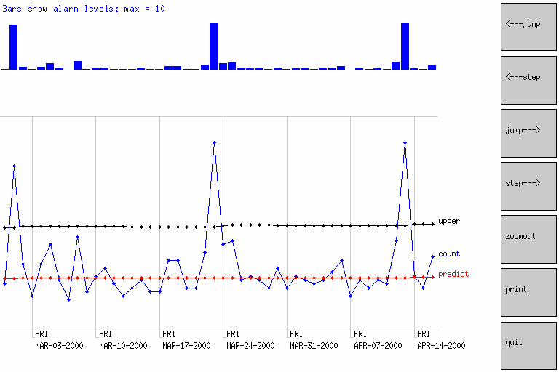
WSARE
Data | Tracking | Method
3 year data (excludes Hanover) | All data from everywhere | What’s Strange About Recent Events
The most surprising thing about MAR-01-2000 is:
Normally 1.5% of records (20/1335) have sendng = CHES and syndrome = other But recently 10.0% of records (39/390) have sendng = CHES and syndrome = other Pvalue = 0.00099975
Which means that in a world where nothing changes we'd expect to have a result this significant about once every 1000 times we ran the program
Looking at the signal detected in alerts 1 and 2
The most surprising thing about MAR-23-2000 is:
Normally 2.3% of records (28/1241) have sendng = CHES and syndrome = other But recently 9.6% of records (45/470) have sendng = CHES and syndrome = other Pvalue = 0.0005
Which means that in a world where nothing changes we'd expect to have a result this significant about once every 1999 times we ran the program
did something happen roughly every three weeks that sent a bunch of folks to CHES with “other” injury?
Auton Lab Walkerton Analysis. Proprietary Information. www.autonlab.org

Slide 55
WSARE
Data | Tracking | Method
3 year data (excludes Hanover) | All data from everywhere | What’s Strange About Recent Events
The most surprising thing about MAY-15-2000 is:
Normally 3.4% of records (46/1345) have sendng = DURHAM But recently 7.6% of records (34/449) have sendng = DURHAM Pvalue = 0.0838333
Which means that in a world where nothing changes we'd expect to have a result this significant about once every 11 times we ran the program
The period leading up to May 20th…
Nothing interesting or significant
The most surprising thing about MAY-16-2000 is:
Normally 18.4% of records (233/1263) have sendng = KINCARDINE But recently 24.9% of records (105/422) have sendng = KINCARDINE Pvalue = 0.4005
Which means that in a world where nothing changes we'd expect to have a result this significant about once every 2 times we ran the program
The most surprising thing about MAY-17-2000 is:
Normally 12.0% of records (156/1305) have sendng = KINCARDINE and syndrome = other But recently 16.9% of records (80/473) have sendng = KINCARDINE and syndrome = other Pvalue = 0.444944
Which means that in a world where nothing changes we'd expect to have a result this significant about once every 2 times we ran the program
The most surprising thing about MAY-18-2000 is:
Normally 23.8% of records (352/1480) have sendng = KINCARDINE and age = D But recently 32.2% of records (156/485) have sendng = KINCARDINE and age = D Pvalue = 0.2005
Which means that in a world where nothing changes we'd expect to have a result this significant about once every 4 times we ran the program
The most surprising thing about MAY-19-2000 is:
Normally 0.0% of records (0/1265) have city = MISSISSAUGA But recently 1.0% of records (4/407) have city = MISSISSAUGA Pvalue = 1.0005
Which is thoroughly insignificant
Auton Lab Walkerton Analysis. Proprietary Information. www.autonlab.org

Slide 56
Now the same analysis with the 3- month-including-hanover data…
Auton Lab Walkerton Analysis. Proprietary Information. www.autonlab.org

Slide 57
WSARE
Data | Tracking | Method
3 month data (includes Hanover) | All data from everywhere | What’s Strange About Recent Events
The most surprising thing about MAY-20-2000 is:
Normally 0.2% of records (2/1123) have city = WALKERTON and syndrome = gastrointestinal But recently 6.5% of records (28/434) have city = WALKERTON and syndrome = gastrointestinal Pvalue = 0.0005
Which means that in a world where nothing changes we'd expect to have a result this significant about once every 1999 times we ran the program
Results 1-5 of the 9 days in the 3 month date in which WSARE issued an alert with a Pvalue exceeding 1 in 1000
All 9 were during or just after the outbreak period
The most surprising thing about MAY-21-2000 is:
Normally 0.7% of records (7/1031) have sendng = W and syndrome = gastrointestinal But recently 9.3% of records (43/463) have sendng = W and syndrome = gastrointestinal Pvalue = 0.0005
Which means that in a world where nothing changes we'd expect to have a result this significant about once every 1999 times we ran the program
The most surprising thing about MAY-22-2000 is:
Normally 0.8% of records (12/1485) have sendng = W and syndrome = gastrointestinal But recently 10.8% of records (51/474) have sendng = W and syndrome = gastrointestinal Pvalue = 0.0005
Which means that in a world where nothing changes we'd expect to have a result this significant about once every 1999 times we ran the program
The most surprising thing about MAY-23-2000 is:
Normally 0.1% of records (1/1390) have city = WALKERTON and syndrome = gastrointestinal But recently 7.8% of records (51/656) have city = WALKERTON and syndrome = gastrointestinal Pvalue = 0.0005
Which means that in a world where nothing changes we'd expect to have a result this significant about once every 1999 times we ran the program
The most surprising thing about MAY-24-2000 is:
Normally 1.2% of records (18/1460) have sendng = W and syndrome = gastrointestinal But recently 12.6% of records (76/603) have sendng = W and syndrome = gastrointestinal Pvalue = 0.0005
Which means that in a world where nothing changes we'd expect to have a result this significant about once every 1999 times we ran the program
Auton Lab Walkerton Analysis. Proprietary Information. www.autonlab.org

Slide 58
WSARE
Data | Tracking | Method
3 month data (includes Hanover) | All data from everywhere | What’s Strange About Recent Events
The most surprising thing about MAY-26-2000 is:
Normally 4.9% of records (66/1347) have syndrome = gastrointestinal But recently 22.0% of records (122/554) have syndrome = gastrointestinal Pvalue = 0.0005
Which means that in a world where nothing changes we'd expect to have a result this significant about once every 1999 times we ran the program
Results 6-9 of the 9 days in the 3 month date in which WSARE issued an alert with a Pvalue exceeding 1 in 1000
All 9 were during or just after the outbreak period
The most surprising thing about JUN-14-2000 is:
Normally 5.0% of records (84/1666) have sendng = W and syndrome = other But recently 13.4% of records (80/597) have sendng = W and syndrome = other Pvalue = 0.00099975
Which means that in a world where nothing changes we'd expect to have a result this significant about once every 1000 times we ran the program
The most surprising thing about JUN-15-2000 is:
Normally 1.5% of records (28/1818) have sendng = CHES and syndrome = other But recently 8.3% of records (45/544) have sendng = CHES and syndrome = other Pvalue = 0.0005
Which means that in a world where nothing changes we'd expect to have a result this significant about once every 1999 times we ran the program
The most surprising thing about JUN-16-2000 is:
Normally 0.2% of records (3/1581) have sendng = GBHSTO and syndrome = other But recently 4.4% of records (21/478) have sendng = GBHSTO and syndrome = other Pvalue = 0.0005
Which means that in a world where nothing changes we'd expect to have a result this significant about once every 1999 times we ran the program
Auton Lab Walkerton Analysis. Proprietary Information. www.autonlab.org
58

Slide 59
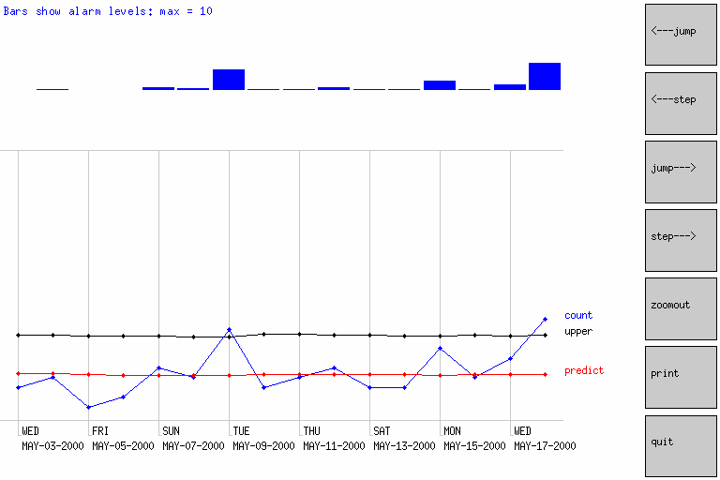
WSARE
Data | Tracking | Method
3 month data (includes Hanover) | All data from everywhere | What’s Strange About Recent Events
The most surprising thing about MAY-15-2000 is:
Normally 3.1% of records (46/1477) have sendng = DURHAM But recently 6.9% of records (34/490) have sendng = DURHAM Pvalue = 0.1505
Which means that in a world where nothing changes we'd expect to have a result this significant about once every 6 times we ran the program
The period leading up to May 20th. May 18th is possibly of interest, though notice that it is not considered significant
The most surprising thing about MAY-16-2000 is:
Normally 0.0% of records (0/1392) have city = LONDON But recently 0.8% of records (4/475) have city = LONDON Pvalue = 0.5005
Which means that in a world where nothing changes we'd expect to have a result this significant about once every 1 times we ran the program
The most surprising thing about MAY-17-2000 is:
Normally 10.8% of records (156/1442) have sendng = KINCARDINE and syndrome = other But recently 15.4% of records (80/520) have sendng = KINCARDINE and syndrome = other Pvalue = 0.6005
Which is thoroughly insignificant
The most surprising thing about MAY-18-2000 is:
Normally 8.4% of records (135/1615) have sendng = HANOVER But recently 12.6% of records (70/555) have sendng = HANOVER Pvalue = 0.308192
Which means that in a world where nothing changes we'd expect to have a result this significant about once every 3 times we ran the program
The most surprising thing about MAY-19-2000 is:
Normally 0.0% of records (0/1381) have city = MISSISSAUGA But recently 0.9% of records (4/460) have city = MISSISSAUGA Pvalue = 1.0005
Which is thoroughly insignificant
Hanover Gastro cases
Auton Lab Walkerton Analysis. Proprietary Information. www.autonlab.org
59

Slide 60
What next?
Want to try some other univariate methods
Get better spatial coding of home locations?
Should do a search for other syndromes/locations with increase early in outbreak
Search on other spatial regions centered on Walkerton
Run WSARE on data in which all the syndrome==other records are removed
Analyse the chief complaint strings to see if there was a pattern in those strings in the days leading up to May 19th that is more specific than the GI syndrome coded by CoCo
Get hold of data about which three-letter postcodes are in which water supply regions and allow home-water-region as another feature in the data
Methods which look at multi-sized time windows (almost everything here looked one day at a time)
See how sensitivity increases with multivariate methods that fuse ED with other data (absenteeism, over-the-counter sales, prescriptions, physician appointments…)
Auton Lab Walkerton Analysis. Proprietary Information. www.autonlab.org
60

